Slide 1

Welcome to our Bookstore
Bookstore Management
By - Nilesh Agarwalla
Register Number: 20BLC1021

Slide 2
Problem Statement
We have to design a management system for the books of that store keeping following things in mind
The bookstore houses books of some fixed genres, like Comics, Horror, Suspense, etc.
In each genre, we have many books and some books can have a series, like Harry-Potter
Every Genre and Book has a unique ID to differentiate it from others.
Also, there's a Series ID, which will be used, if the book has its own series.
Also, we have to keep a record of their quantity, so that if somebody asks about the book, we can tell whether the book is available with us or not.
Also, there should be a way to delete a book's record, in case that book is completely sold out or the store doesn't want to keep it anymore.

Slide 3

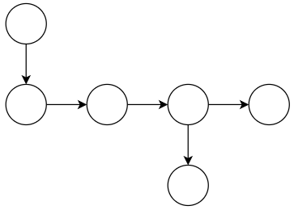
Design of Data-structure for the Problem Statement
Array of Genres
Genre-1
Genre-2
N-Ary Tree of Books
and their series
(if exists) of a Genre
Genre-1
Book-3
Part-1
Book-1
Book-2
Book-4
Book-3
Part-2

Slide 4
Justification For The Above Design
We will be having fixed no. of Genres with us, each having their Unique ID for identification. Hence, we can use the array as the length will remain fixed and can be easily traversed due to its small length.
Now, we wanted to arrange the books of that Genre in such a way that the books can be added without any changing the structure length every time and also, to connect the books of the same series in a different way so that we can distinguish between different books of different/same series. That's why we are using N-ary tree, which can be easily implemented using doubly-linked list concept.

Slide 5

Illustration of Design
This is our Computer Screen, to which we will come back again when going through each of the options
Welcome to the Bookstore
Insert a Book Record
Find a Book Record
Delete a Book record
Buy Book

Slide 6
Sample Data Which will be used in Illustration
Genre | ID
Comic | 0
Horror | 1
Academic | 2
History | 3
Book Name | Genre ID | Book ID | Serial ID | Price | Qty
Geronimo Stilton: Beginning | 0 | 1001 | 101 | 350 | 20
Discovery of India | 3 | 1002 | NULL | 300 | 50
Geronimo Stilton: Rumble in the Jungle | 0 | 1003 | 102 | 350 | 30
IT | 1 | 1004 | NULL | 300 | 0
CS with Python By Sumita Arora XI | 2 | 1005 | 51 | 400 | 20
CS with Python By Sumita Arora XII | 2 | 1006 | 52 | 400 | 30
JEE Prep Book for Class XI Physics | 2 | 1007 | 151 | 370 | 15

Slide 7




Hi Joseph! What brings you here today?
All these books have arrived today, enter them in computer, then I will arrange them.
Ok!
Hi James !
Click here

Slide 8
Computer Screen
Welcome to the Bookstore
Insert a Book Record
Find a Book Record
Delete a Book record
Buy Book
Click on an option

Slide 9
James, Mr. Wade
has asked whether the book “CS with Python Sumita Arora XII"
is available?
Just give me a second Joseph I will search and tell you.
Click here

Slide 10
Ok Joseph! I will delete its record for now, you ask the distributor to send more
James, the Book
“CS with Python Sumita Arora XI” is unavailable.
Click here

Slide 11
Ok Joseph. Let me check whether we have this much books and if have, will make the bill.
James, We have got
a order of 10 books of " Discovery of India ".
Click here

Slide 12


1. Insert a Book Record
So, this our array, in which we have already Inserted the genres we have and The Genre ID Corresponds to the index of the array
0
1
2
3
Now, if I want to add a book, let’s say Book ID – 1002. In that case first I will compare the Genre ID of it (which is 3) with others, and find the index of array.
3, 1002, NULL
3≠0, Hence move to next index
3≠1, Hence move to next index
3≠2, Hence move to next index
3=3, Hence we got our index
0
1
2
3

Slide 13
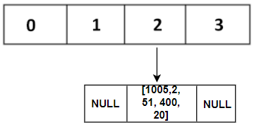
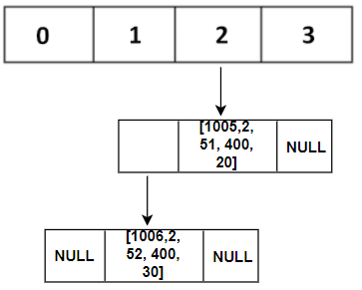

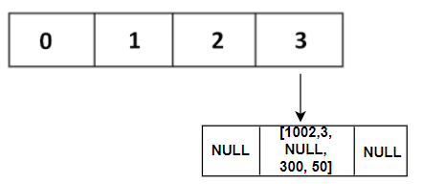
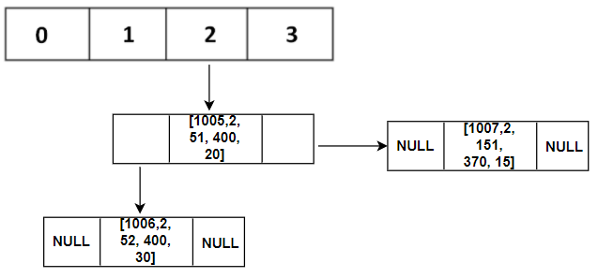
1. Insert a Book Record
Now, if I want to add three books, 1005, 1006 and 1007, we will again check for index, which is the third one, 2.
First we will add 1005 as we did 1002.
Now, we find that 1006 has a Serial ID next to 1005. Hence it will go to series pointer of 1005.
Also, 1007 has no Serial ID but same genre ID. Therefore, it will go to book pointer of 1005
Now, we will add the book at that index.
0
1
2
3
Here, we are implementing the doubly-linked list for N-ary tree. Hence, the book node will look somewhat like this, where Series pointer will generally be NULL.
Therefore, The array will now look like this, after insertion

Slide 14
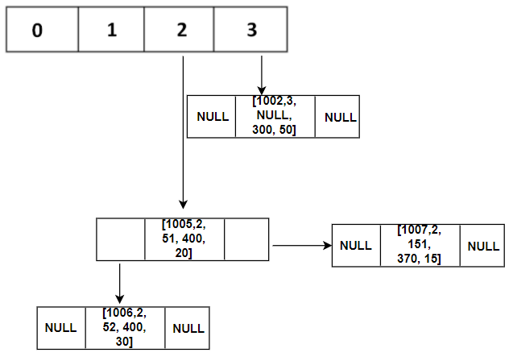
1. Insert a Book Record
Hence, My final array after these insertions will look like this
Click here

Slide 15
2. Find a Book Record
For finding a book record, two major things necessary are : Genre ID and Book ID.
With the Genre ID, we can go to the desired genre as we did in Insertion.
Once there, we will compare the Book ID, if it matches then fine, else we will find whether it belongs to that series, if yes then go into that series using Series pointer
If its not a part of that series, we will use Book pointer to move to next book and repeat the above steps till we get the book.
Let’s find the book “CS with Python by Sumita Arora XII”

Slide 16

2. Find a Book Record
First we will check for that Genre ID, which we get as 2
Now we will compare the book IDs. For the first book node we found that, 1006 ≠ 1005.
Therefore, we now check the Series ID of the book, which should be in the range of the present book-node. We find that 52 is in the range starting from 51.
Therefore, we now go to the next element via Series Pointer and check the book ID, which is the same as reqd. book ID 1006. hence, the book is found.
Click here

Slide 17
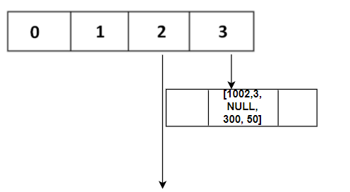





3. Delete a Book Record
We have to delete “CS with Python Sumita Arora XI”.
We will find the book node using “Find Book”, which is as below.
Now, first change the Book pointer 1006 from NULL to point towards 1007.
Now, change the head of genre 2 to be the book-node 1006 and series and book pointer of 1005 to NULL
Delete the 1005 node.
NULL
NULL
Click here

Slide 18
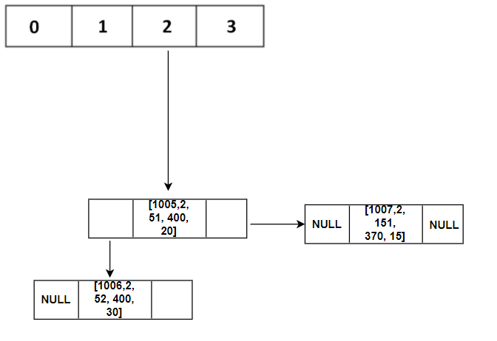



4. Buy a Book
We have to find the availability and calculate the total price of “Discovery of India”.
We will find the book node using “Find Book”, which is as below.
Now, we will store its quantity and price in variables, rs and qty..
If the quantity is same or greater than the reqd. one, just subtract the reqd quantity from the existing one and store in node’s array.
In case of same, delete the book-node using “Delete book” option. (here, it is not reqd.)
Find and display the product of price and reqd. qty.
qty = 50,
rs = 300
reqd = 10
Price = 300*10 = 3000
Click here

Slide 19
Conclusion
In the previous slides, I showcased how this design can work in real-life book store
Also, one drawback of this is nothing is stored permanently; till the program runs, the data is there. But with knowledge of databases like SQLite and its integration with C++, this data can be saved for future use.

Slide 20
Thank You For Visiting us

